Slide 1
Oil Price Prediction
Group 2:
Date:17/06/2023 Guided by: Karthik
+
Ms. Anusree Raghunath
Ms. Vaishnavi Sanjay Nikhare
Mr. Pranav Ashok Dharpure
Ms. Akanksha Ramdas Kumbhar
Ms. Vinaya Bhat
Mr. Vinay N. Gangammanavar
Mr. Sandipan Biswas

Slide 2
PROBLEM STATEMENT
Oil is a product that goes completely in a different direction for a single market event as the oil prices are rarely based on real-time data, instead, it is driven by externalities making our attempt to forecast it even more challenging.

Slide 3
Project Flow-
Defining Project objective
Data collection from various source
EDA-Exploring and Visualize the data.
Data pre-processing Time series decomposition
Apply different forecasting methods like ARIMA,FB prophet & test the accuracy of each model.
Evaluate and compare Performance.
Implement the forecast System

Slide 4
DATA DESCRIPTION
The data file contains 2 features
DATE
PRICE
Based on the data we have to build the best model which gives the maximum performance

Slide 5
EDA(Exploratory Data Analysis)

Slide 6
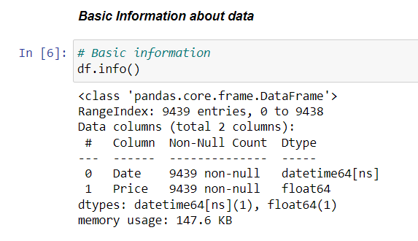
df.info()
Here we provide a summary of a DataFrame object, which displays information about the data contained within the DataFrame. It includes details such as the column names, the number of non-null values in each column, and the data types of the columns.

Slide 7
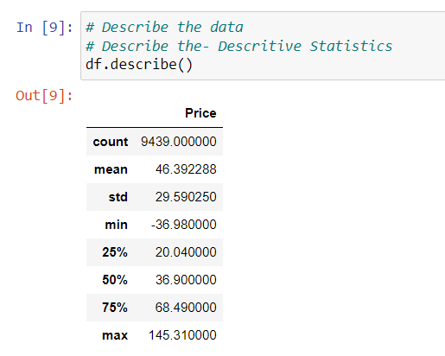
df.describe()
This function is commonly used to provide descriptive statistics of a DataFrame object .It can help us understand the statistical properties of the dataset, which is essential for data analysis and model building.

Slide 8
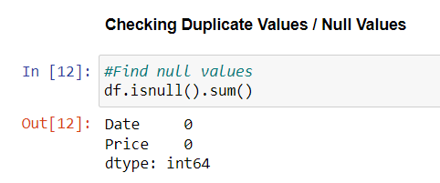
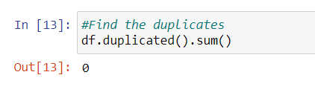
df.isnull().sum()
Here we check the number of missing values in each column of the DataFrame .We can clearly see that there is no null values present .
df.duplicated().sum()
Here we count the number of duplicate rows in the DataFrame . It returns 0 that means no duplicated value

Slide 9
Visualization

Slide 10
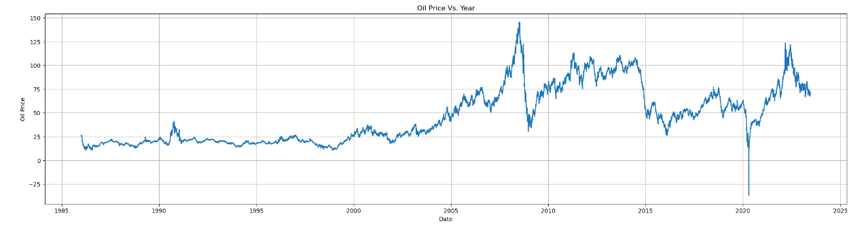
Line Plot
Line plot shows an increasing trend except for the two major dips
1. During the recession
2. Pandemic

Slide 11
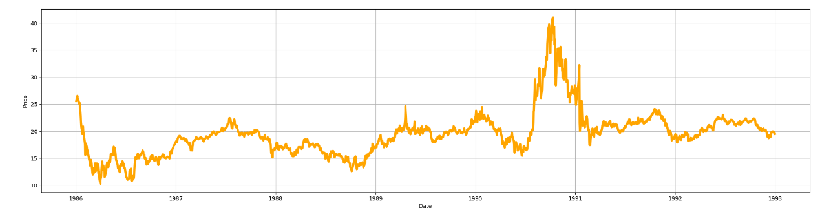
Line Plot (1986-1993)
In 1986, oil prices plummeted to historic lows . By the end of 1990 the oil price surged and prices experienced significant volatility and surged to their highest levels .Then we can see price drop,the slowdown continued into 1991 ,after which the price seems to be stable.

Slide 12
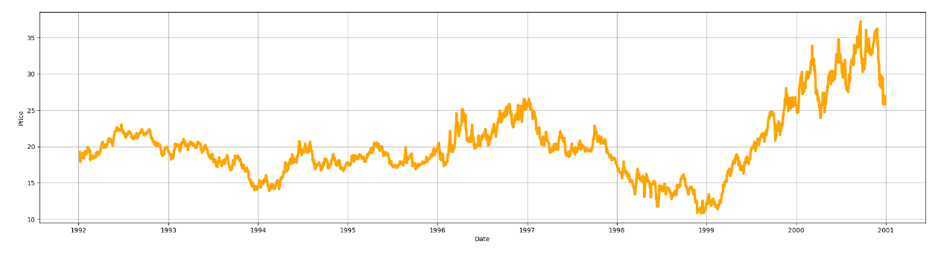
Line Plot (1993-2000)
The period from 1993 to 2000 witnessed various factors influencing oil prices.During 1997 to 1999 there was a severe downturn, demand for oil decreased, contributing to a decline in prices during this period.Following that we can see gradual increase in the price with significant volatility.

Slide 13
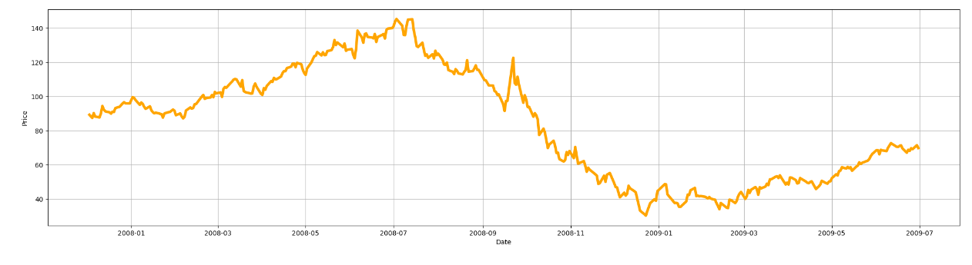
Line Plot (2007-2009) (Recession period)
The period from 2007 to 2009 witnessed significant volatility and notable events that influenced oil prices.The global financial crisis, triggered by the collapse of the US housing market and the subsequent banking sector turmoil, had a profound impact on oil prices.

Slide 14
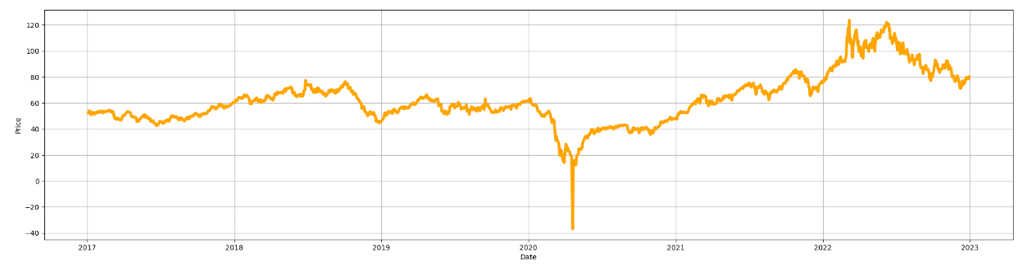
Line Plot (2017-2022) (Pandemic period)
From 2017 to initial month of 2020 we can see a constant trend in the price .The global outbreak of the COVID-19 pandemic in early 2020 had a profound impact on oil prices.Lockdowns, travel restrictions, and reduced economic activity resulted in a significant decline in oil demand. This led to a dramatic drop in oil prices during the first half of 2020.As economies rebound and restriction eased oil demand rised potentially putting upward pressure on prices.

Slide 15
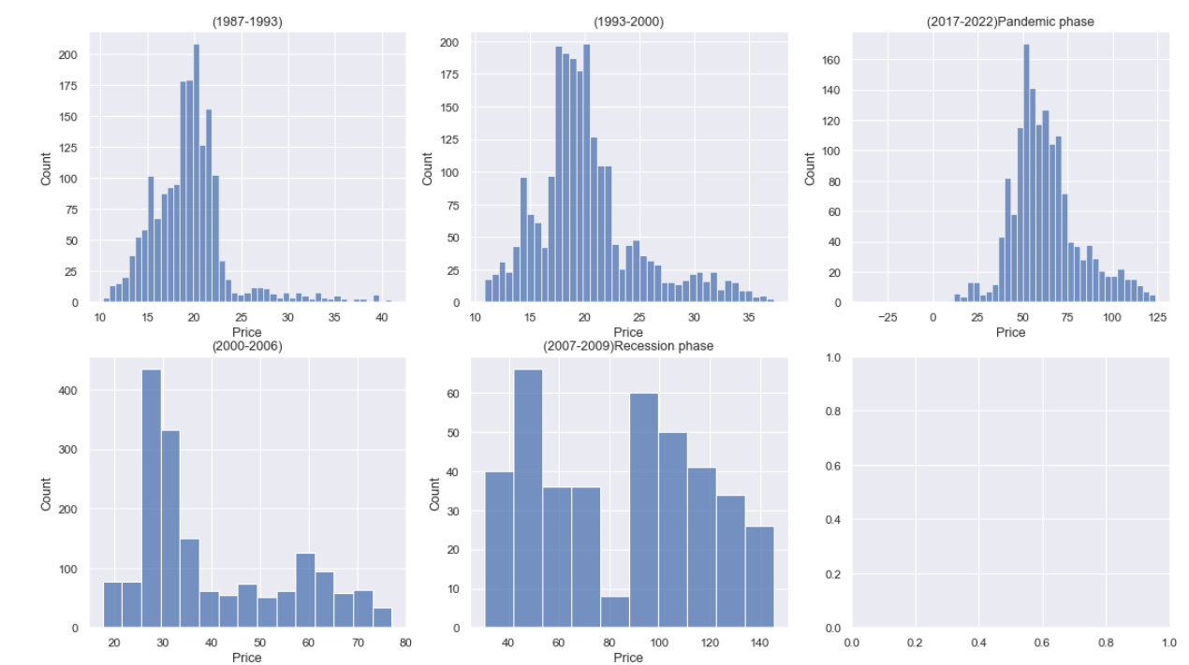
Histogram through different time periods
Histograms across different time periods shows that data is not normally distributed.

Slide 16
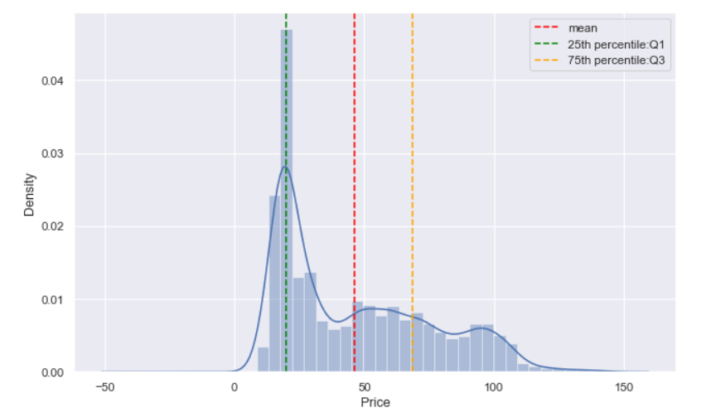
Displot
Here we generated a displot (histogram with kernel density estimation) of the oil price predictions, showing the frequency distribution of the prices over the specified time period.

Slide 17
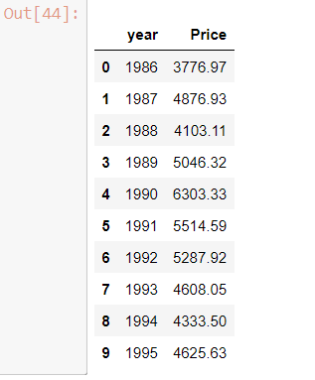
Visualizing the sum of all sales each year. We can do that using group of Price and Date and group by Year
Year wise total sum of oil price.

Slide 18
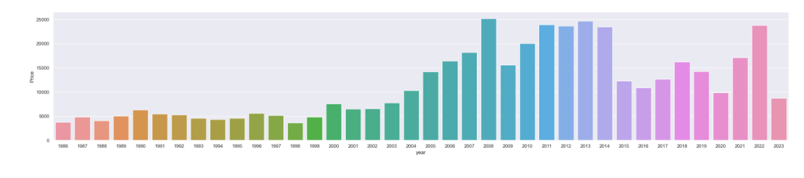
Cat Plot
By plotting Year against the oil prices, a cat plot can help identify any recurring seasonal patterns in the data. Seasonality is often present in oil prices due to factors like changes in demand during different seasons or geopolitical events affecting supply. Understanding the seasonal variation can be valuable for predicting future price movements.

Slide 19
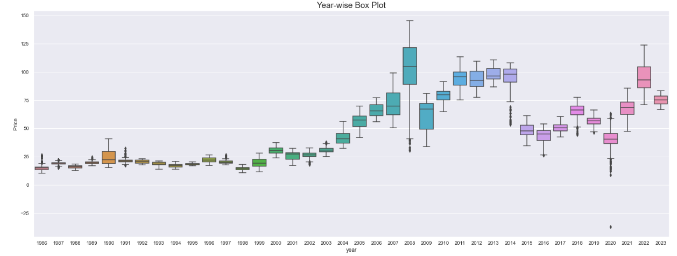
Boxplot (year wise)
By examining the box plot, we can gain insights into the central tendency, spread, and potential anomalies or extreme values in the oil price predictions.Here from this plot we can visualize the Prices experienced historic lows, with prices briefly turning negative in 2020

Slide 20
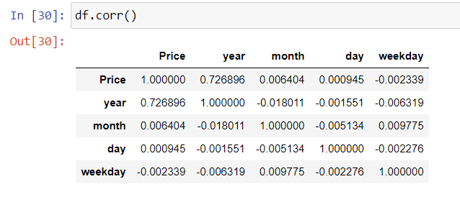
Correlation Plot - EDA
There is positive correlation between price and year and rest of the variables show no or zero correlations

Slide 21
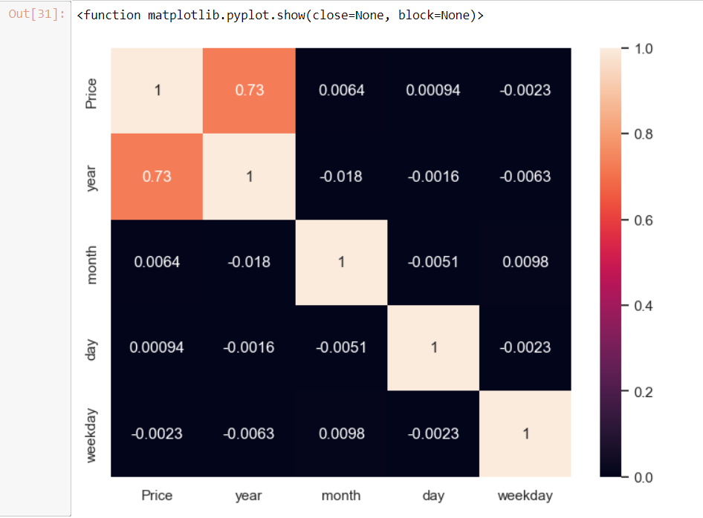
Heat Map
Heat map visually shows the same positive correlation between price and year as earlier

Slide 22
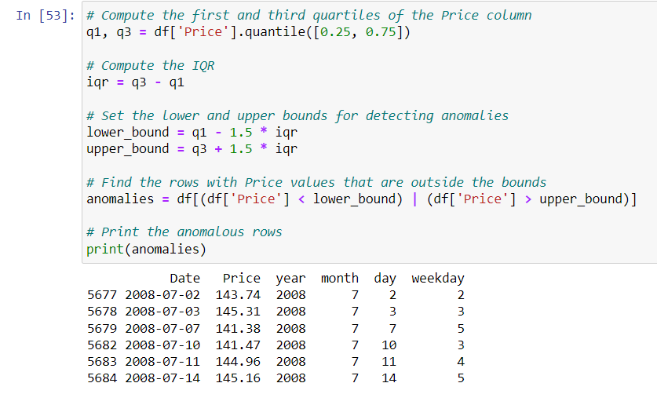
Anomaly detection
Here's an overview of how to perform outlier detection using the IQR method. Any data points that fall below the lower bound or above the upper bound are considered outliers.Here the function return the anomalies.

Slide 23
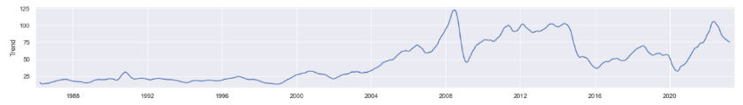
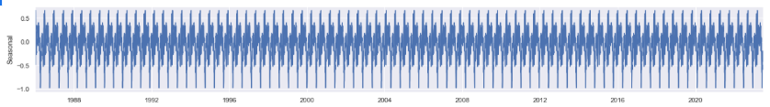
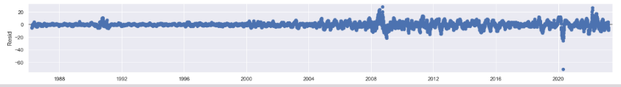
Time Series Decomposition
The trend component represents the long-term behavior or direction of the time series. It captures the underlying growth or decline in oil prices over time.
The seasonal component reflects the recurring patterns or fluctuations that occur yearly
The residual component ideally exhibit a random pattern without any discernible trends, seasonality, or systematic patterns.

Slide 24
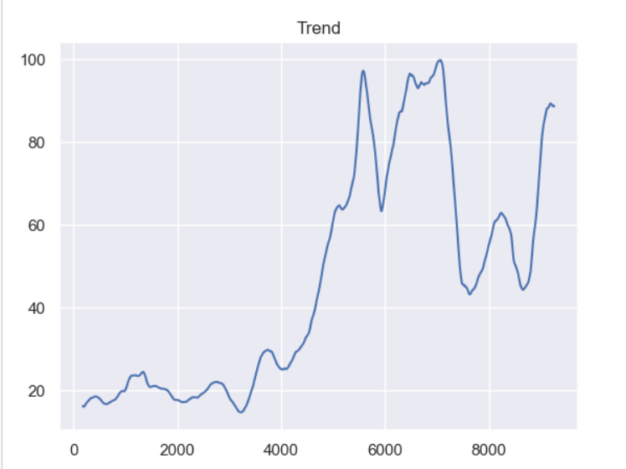
Trend
plt.plot(result.trend)
plt.title("Trend")
Trend graph after choosing window size of 365(yearly)
Since the price column had zero and negative values we choose the additive time series

Slide 25
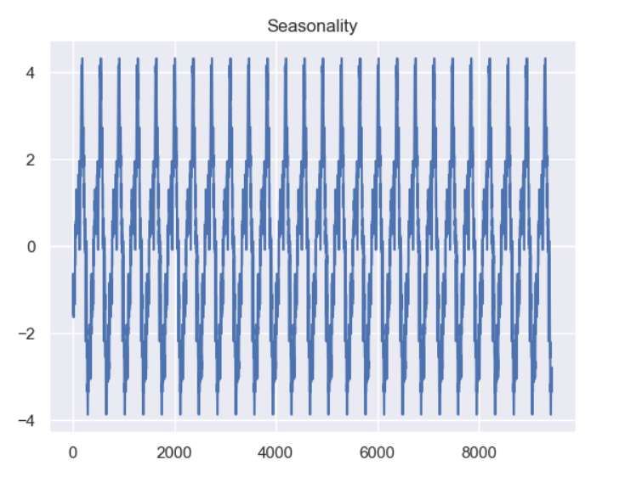
Seasonality
plt.plot(result.seasonal)
plt.title("Seasonality")
seasonality graph after choosing window size of 365(yearly)

Slide 26
Checking for stationarity
What is stationarity?
Statistical properties of the process do not change over time
Types:
Strong stationary
Weak stationary
Assumptions of Weak stationarity :
Constant Mean
Constant Variance

Slide 27
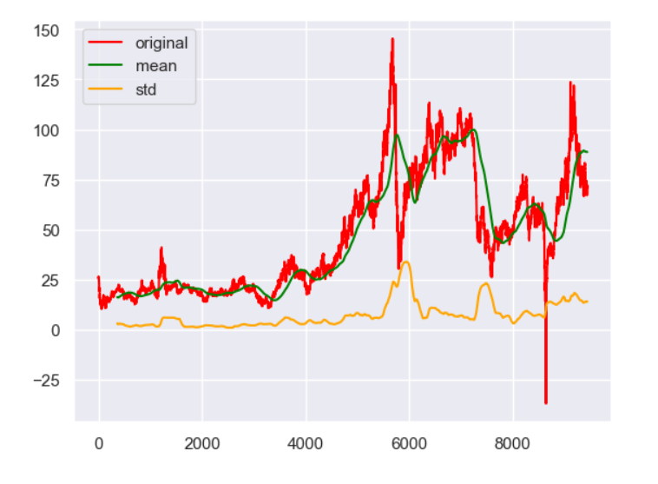
Methods to check for stationarity:
Visual method
Dickey fuller test
Visual method:
rolling mean = df.rolling(window =365).mean()
rolling_std= df.rolling(window =365).std()
From the graph its clear that mean and standard deviation are not constant snd vary at different time period hence Data is not stationary

Slide 28
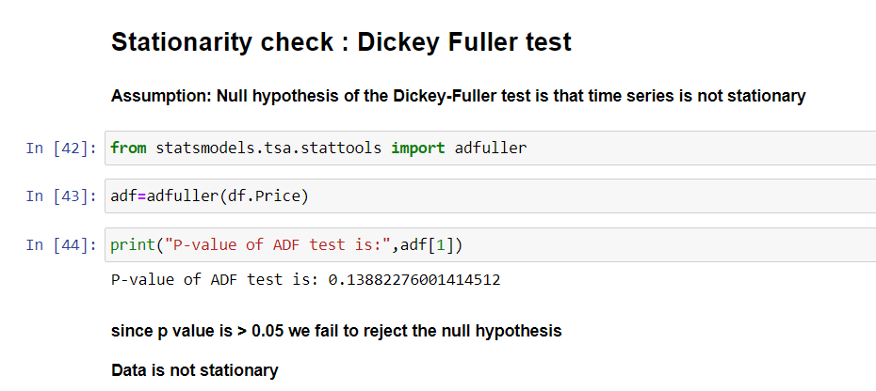
Dickey Fuller test:
Null hypothesis: Time series is not stationary
After performing the ADF test we get p value and select a significance level of 0.05
Since our p value is greater than 0.05 we fail to reject the null hypothesis
Time series is not stationary
Since Time series is not stationary we try to make it stationary by performing difference operation

Slide 29
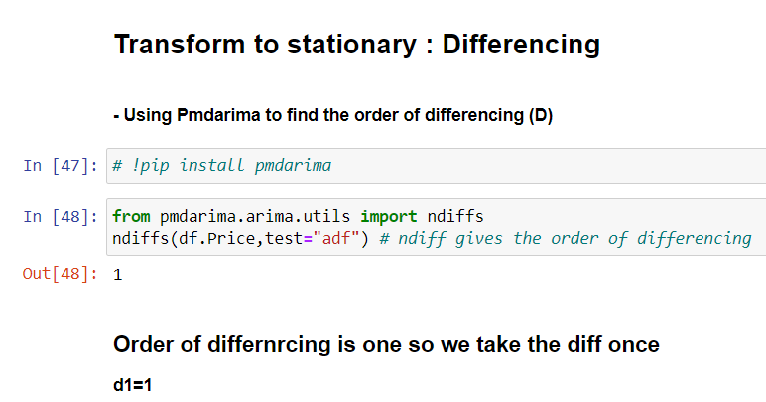
Making series stationary by Differencing method
We have used pmd arima library to check for order of differencing
We get the order as 1 which we select as the value of “d” in the ARIMA model

Slide 30
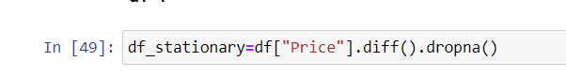
We apply the .diff() function on the price column of our data and drop the na values.
Since we have selected the order of differencing as 1 we only get a single na value for the first entry in the dataset .

Slide 31
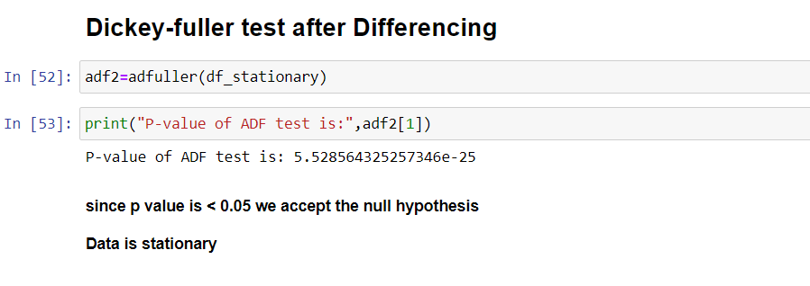
Dickey fuller test after performing difference
After performing difference operation we see that the p value of ADF test is less than the significance level of 0.05. hence the Time series is stationary.

Slide 32
Now that our Series is stationary we try to fit our first model.
1. ARIMA: Autoregressive integrated moving average
It is a class of statistical algorithms that captures the standard temporal dependencies that is unique to a time series data.
An ARIMA model has three component functions:
AR (p), the number of lag observations or autoregressive terms in the model.
I (d), the difference in the nonseasonal observations
MA (q), the size of the moving average window.
Takes the past values to predict the future values.

Slide 33
P Term: order of the auto regressive term.
Refers to the number of lags to be used as predictors.
We can find the required number of AR terms by inspecting the PACF (partial auto corelation function.
PACF represents the correlation between the series and its lags.
q Term: order of the Moving Average term.
Refers to the number of lagged forecast errors that should not go into the ARIMA model to be used as predictors.
We can find the required number of MA terms by considering the ACF plot (Auto corelation function.

Slide 34
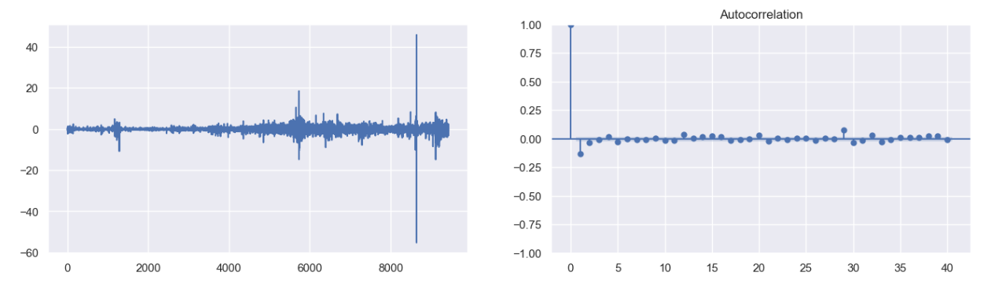
ACF plot before performing differencing
ACF plot after performing differencing

Slide 35
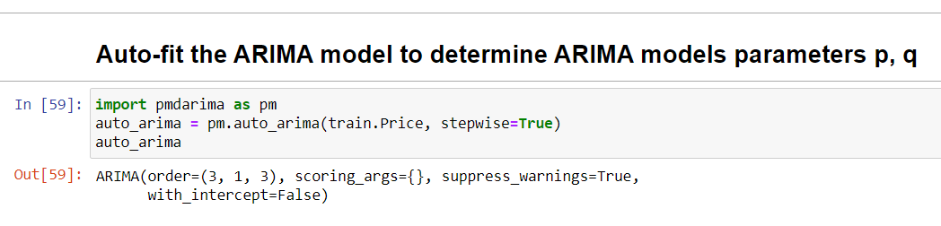
Since the order of differencing was 1 hence the d term in ARIMA will be 1.
We can find values of p and q in the ARIMA model with the help of PACF and ACF graphs respectively but we will use the auto arima library to find the values.
With the help of pmdarima we found the value of p=3 , d=1 and q=3.
We plug these values of p,d,q in the ARIMA model.

Slide 36
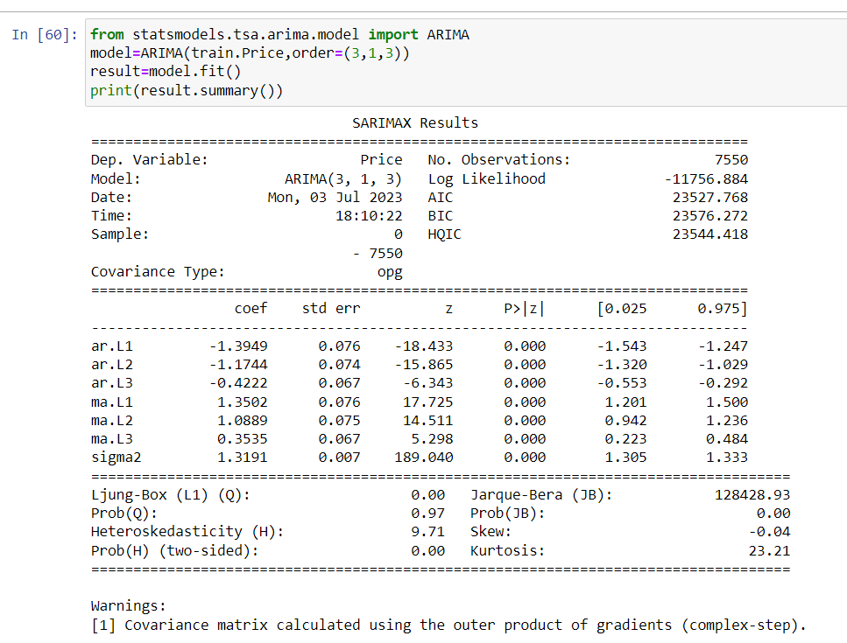
Training the model

Slide 37
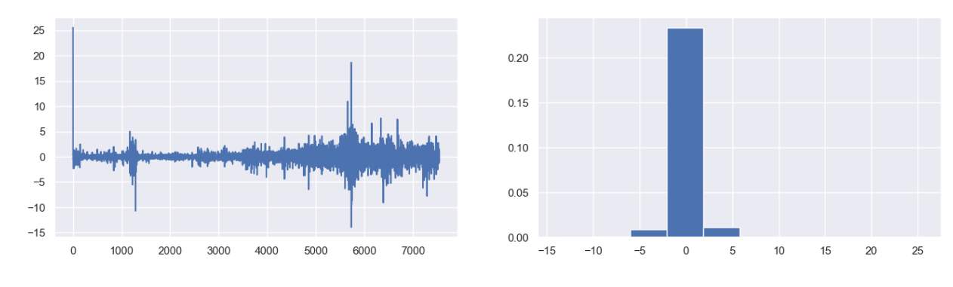
Residual plot
The errors are centred around zero and are normally distributed.

Slide 38
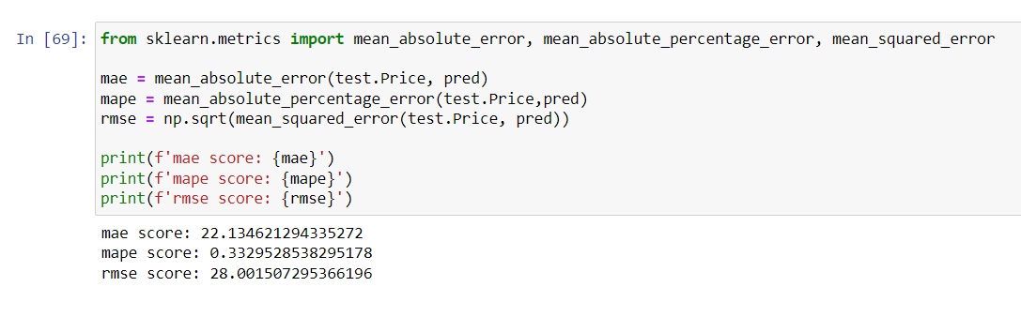
Model evaluation

Slide 39
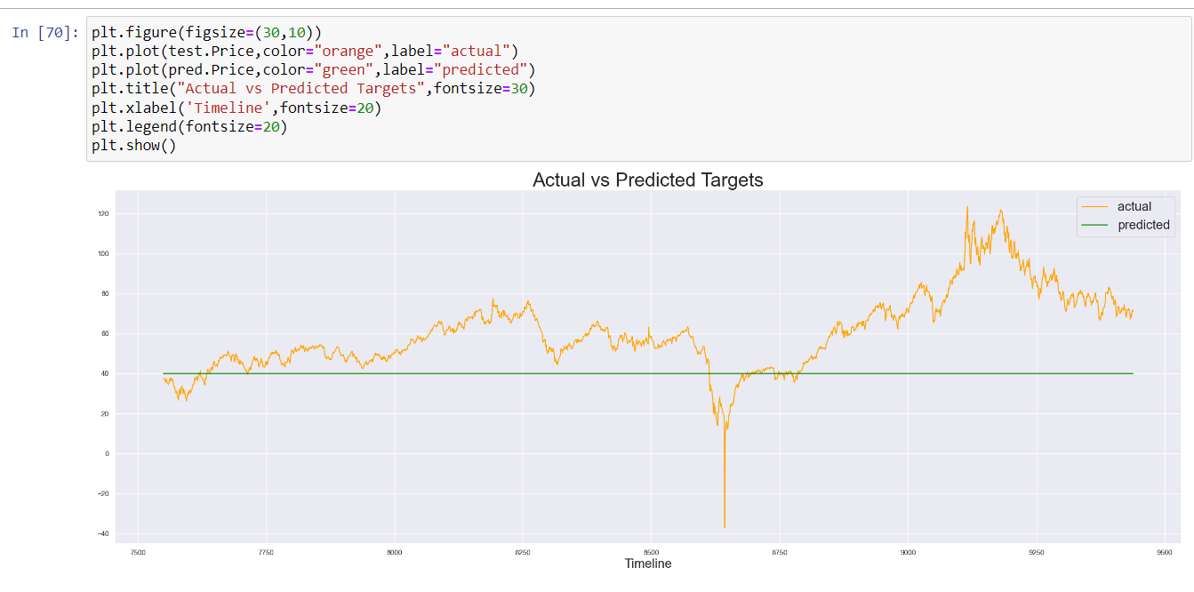
Actual vs Predicted plot

Slide 40
FB Prophet model
Advantages of Prophet :
1. Accurate and fast - Prophet is accurate and fast. It is used in many applications across Facebook for producing reliable forecasts for planning and goal setting.
2. Fully automatic - Prophet is fully automatic. We will get a reasonable forecast on messy data with no manual effort.
3. Tunable forecasts - Prophet produces adjustable forecasts. It includes many possibilities for users to tweak and adjust forecasts. We can use human-interpretable parameters to improve the forecast by adding our domain knowledge.

Slide 41
Advantages of Prophet :
4. Available in R or Python - We can implement the Prophet procedure in R or Python.
5. Handles seasonal variations well - Prophet accommodates seasonality with multiple periods.
6. Robust to outliers - It is robust to outliers. It handles outliers by removing them.
7. Robust to missing data - Prophet is resilient to missing data.
Installation of Prophet:
pip install fbprophet

Slide 42
Prerequisites for prophet model :
Prophet follows the sklearn model API. We create an instance of the Prophet class and then call its fit and predict methods.
The input to Prophet is always a dataframe with two columns: ds and y.
The ds (datestamp) column should be of a format expected by Pandas, ideally YYYY-MM-DD for a date or YYYY-MM-DD HH:MM:SS for a timestamp. The y column must be numeric, and represents the measurement we wish to forecast.

Slide 43
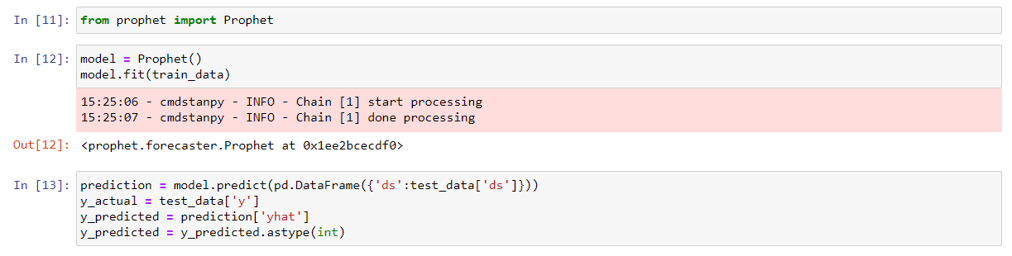
Model creation and predicting for test data:
We fit the model by instantiating a new Prophet object. Any settings to the forecasting procedure are passed into the constructor. Then you call its fit method and pass in the historical dataframe.
Predictions are then made on the test data.

Slide 44
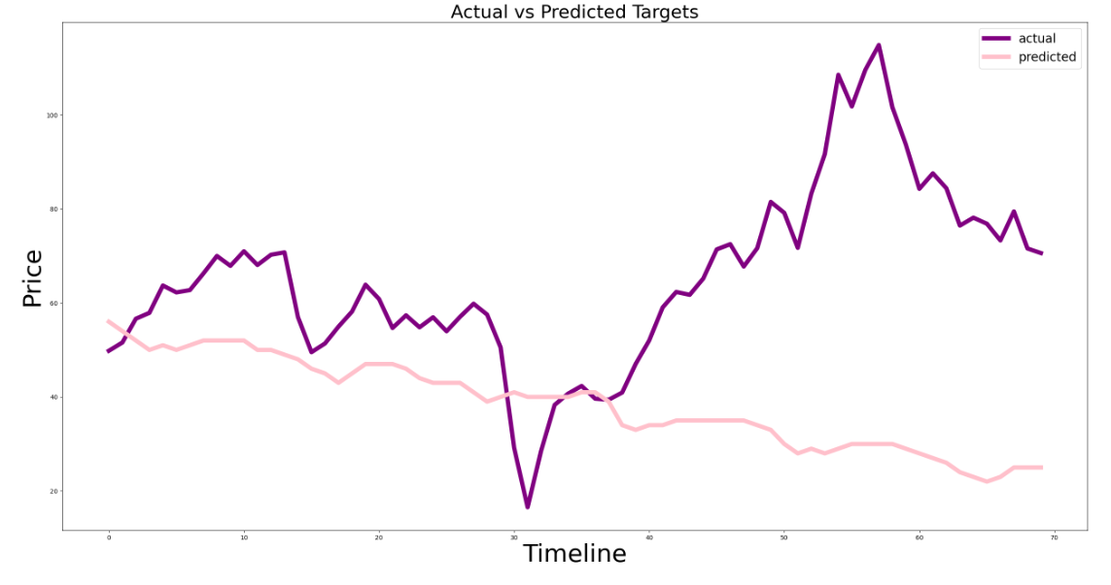
Comparison of Actual test data and prediction on test data :
We see a decreasing trend as the original test data shows in the initial state and it also has some seasonality.
It fails to capture the increasing trend in the later half as shown in the test data.

Slide 45
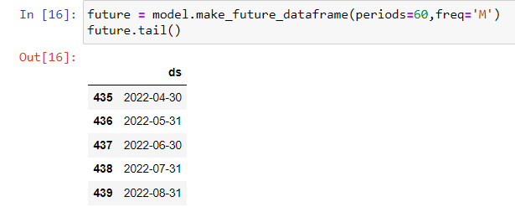
Creating future data frame for forecasting :
Predictions are then made on a dataframe with a column ds containing the dates for which a prediction is to be made using Prophet.make_future_dataframe.
You can specify the frequency as well (monthly, daily or yearly) , in our case we have selected frequency as 60 months.

Slide 46
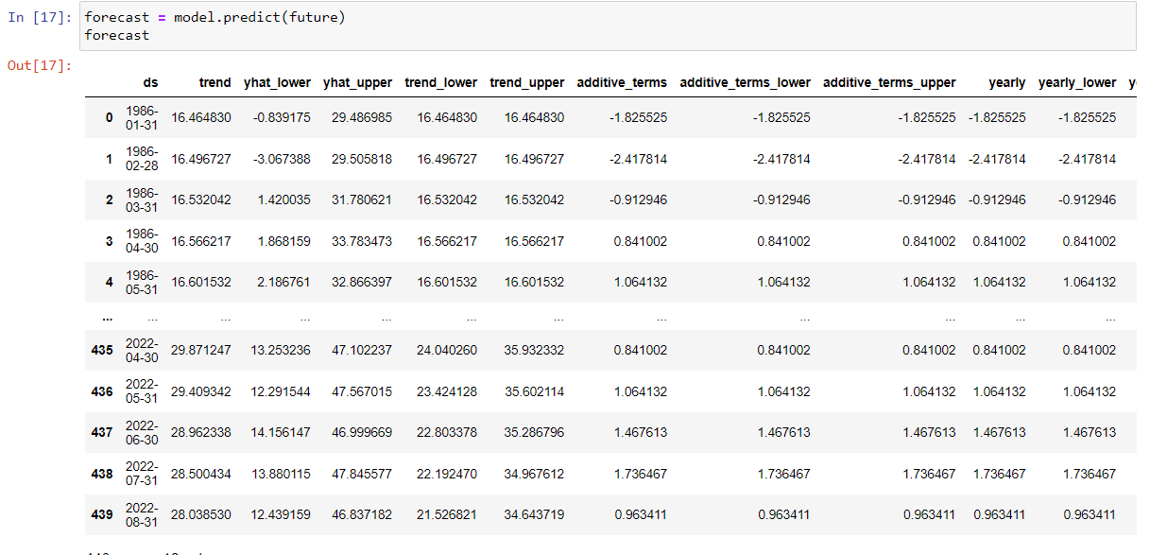
Forecasting for next 60 months :
Predictions for next 60 months , there are 16 different columns to analyze along with the predictions.

Slide 47
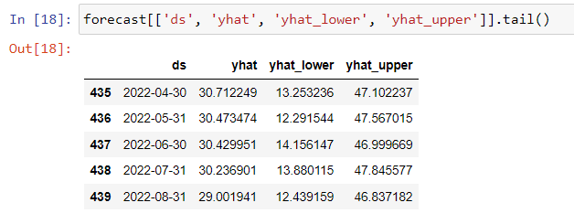
The predict method will assign each row in future a predicted value which it names yhat. If you pass in historical dates, it will provide an in-sample fit. The forecast object here is a new dataframe that includes a column yhat with the forecast, as well as columns for components and uncertainty intervals.

Slide 48
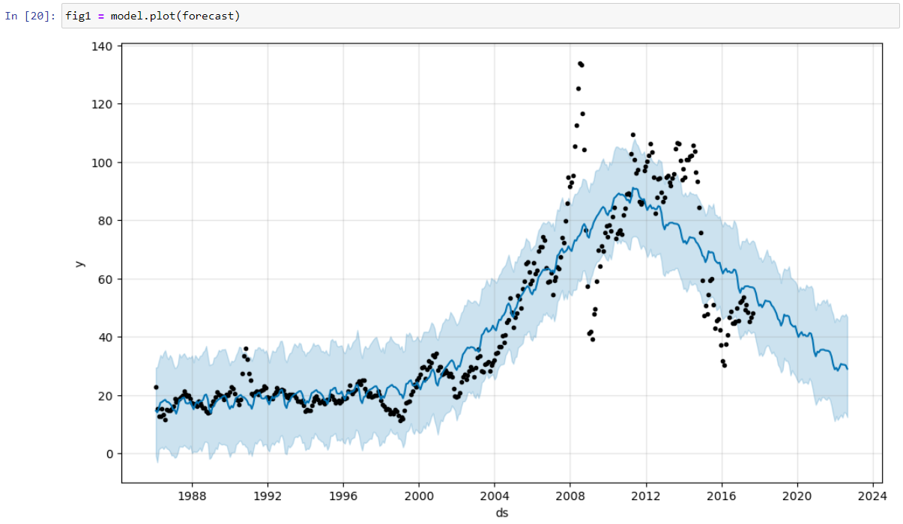
Plot of 60 months forecasted data :
Model.plot gives the forecasted (yhat) price graph.
Graph shows decreasing trend with seasonality.

Slide 49
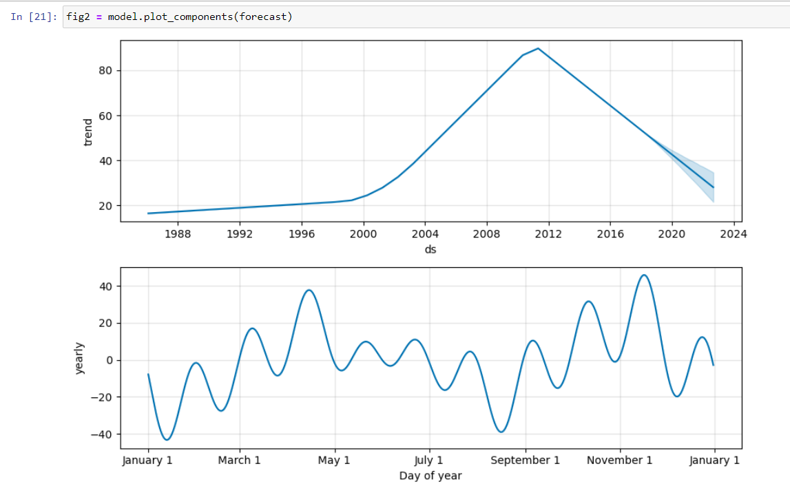
Prophet model Trend component :
The first graph shows the overall trend which indicate an increasing trend till 2010,later trend decreases and we can also see the upper limit ,lower limit of yhat for the forecasted results.
The second graph shows the yearly trend with both increasing and decreasing trend values.

Slide 50
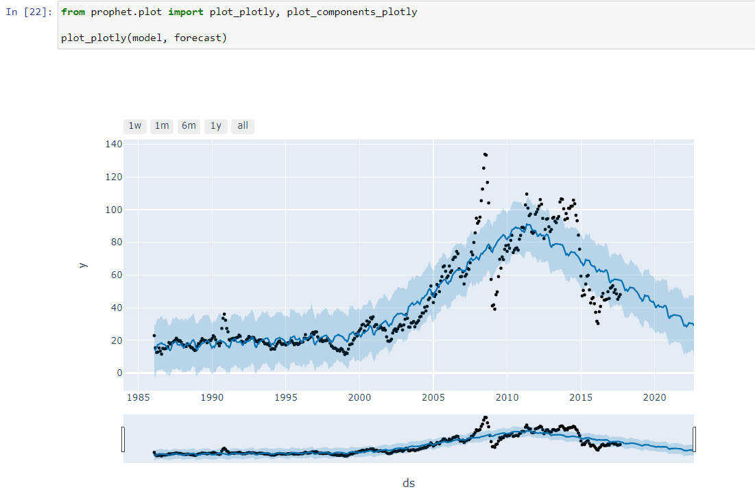
Forecasted graph from plotly :
The graph uses plotly from FB prophet , we can scroll through the graph to a specific time period for detailed visualization , there is a option to see the graph for 1 week , a month , six months or yearly basis.

Slide 51
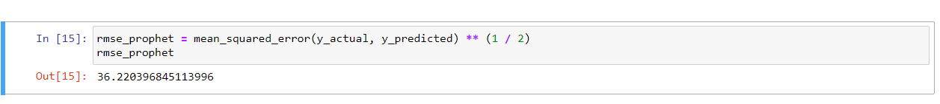
Model Evaluation :
The RMSE value for the prophet model is 36.22.

Slide 52
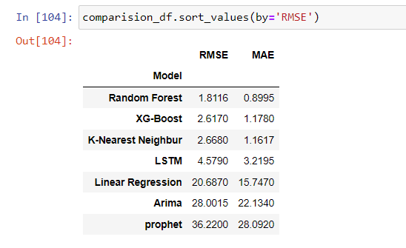
All models comparison :
The RMSE value for random forest is lowest compared to other models.

Slide 53


Model Deployment
Model deployment is done using Streamlit :
We are deploying two models
1. FB Prophet
2. Random forest

Slide 54
FB Prophet deployment

Slide 55
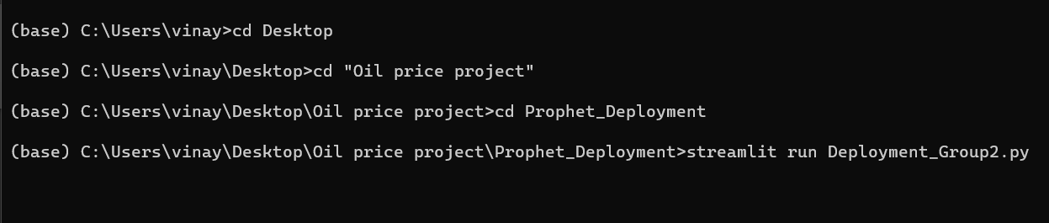
Anaconda prompt commands for Prophet model :

Slide 56
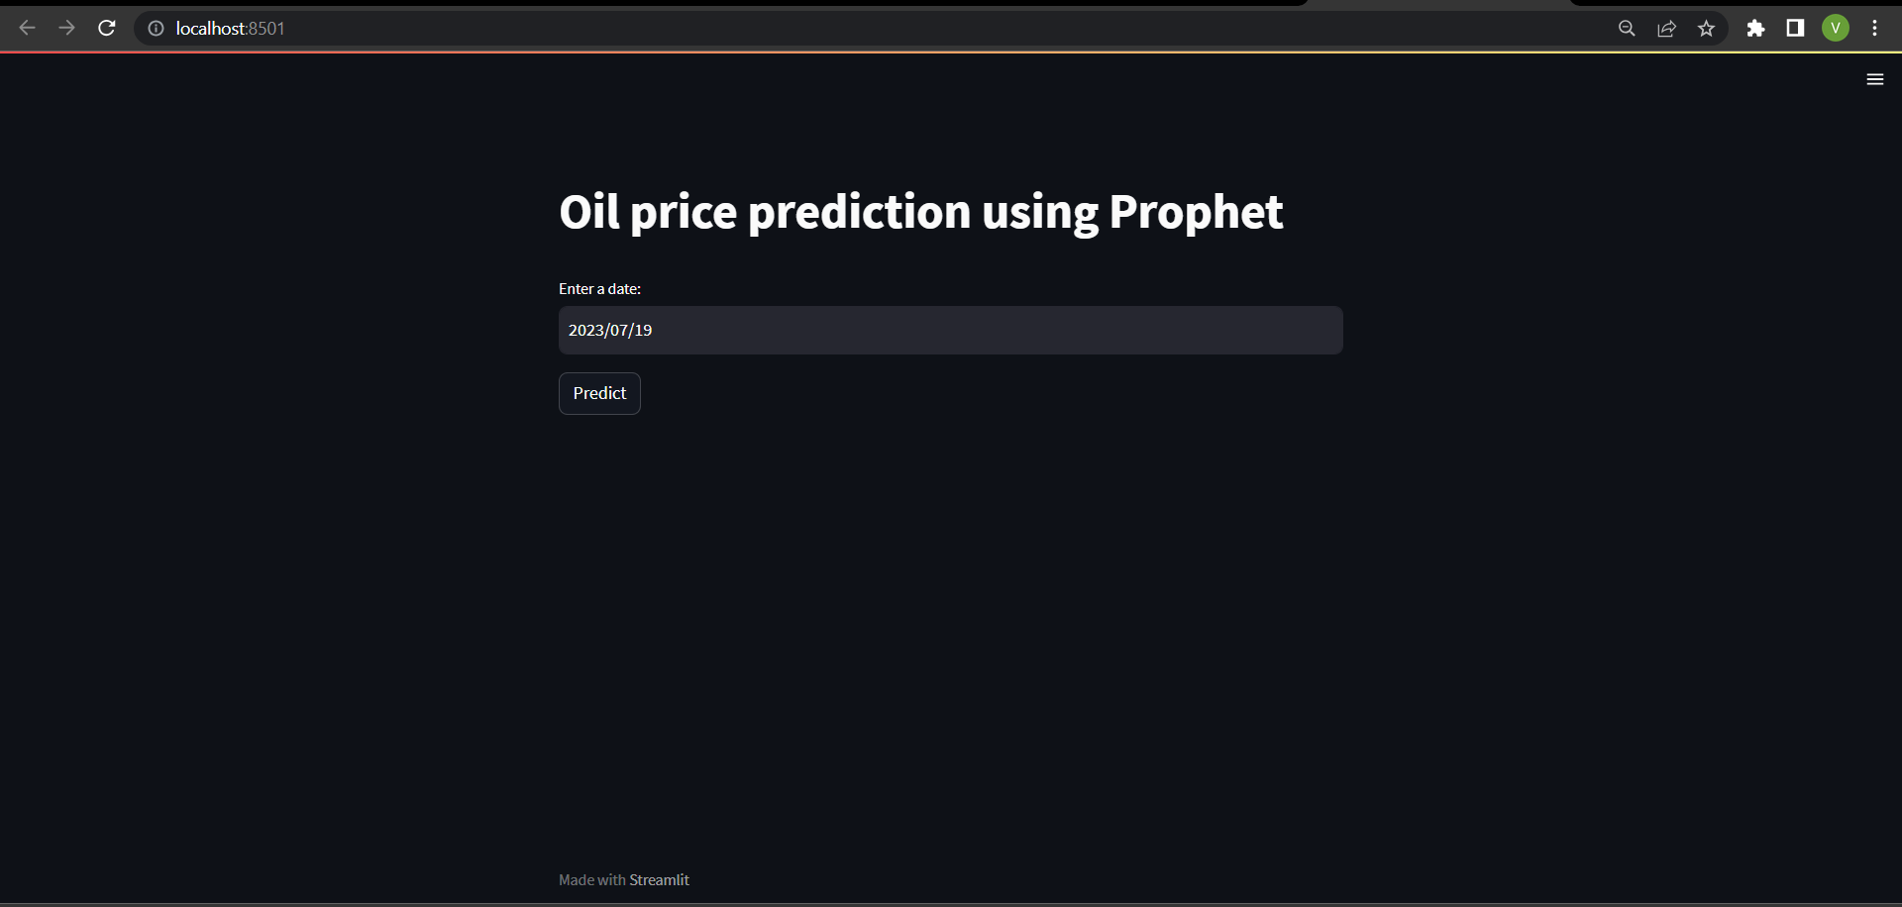
Web page:

Slide 57
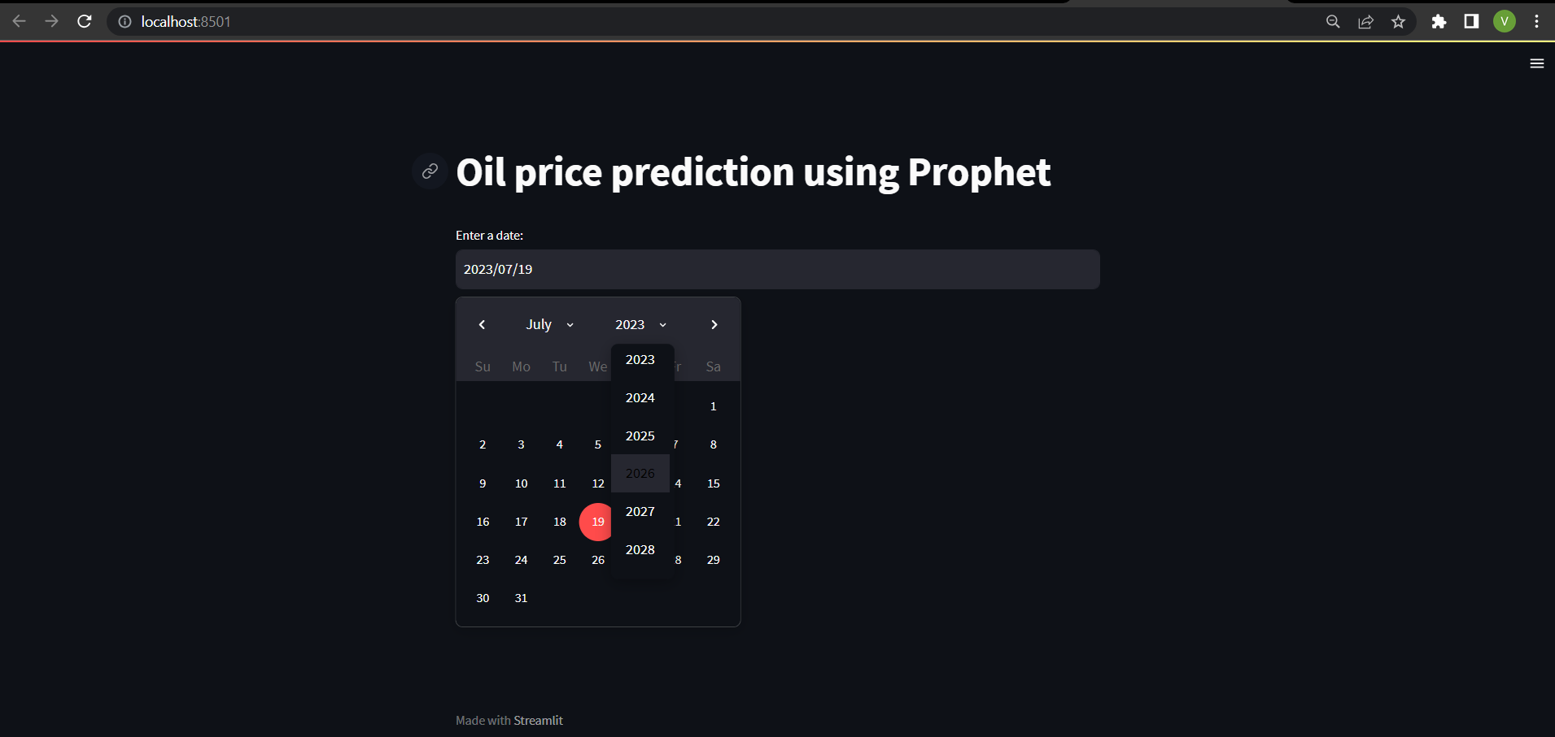
Date selection :

Slide 58
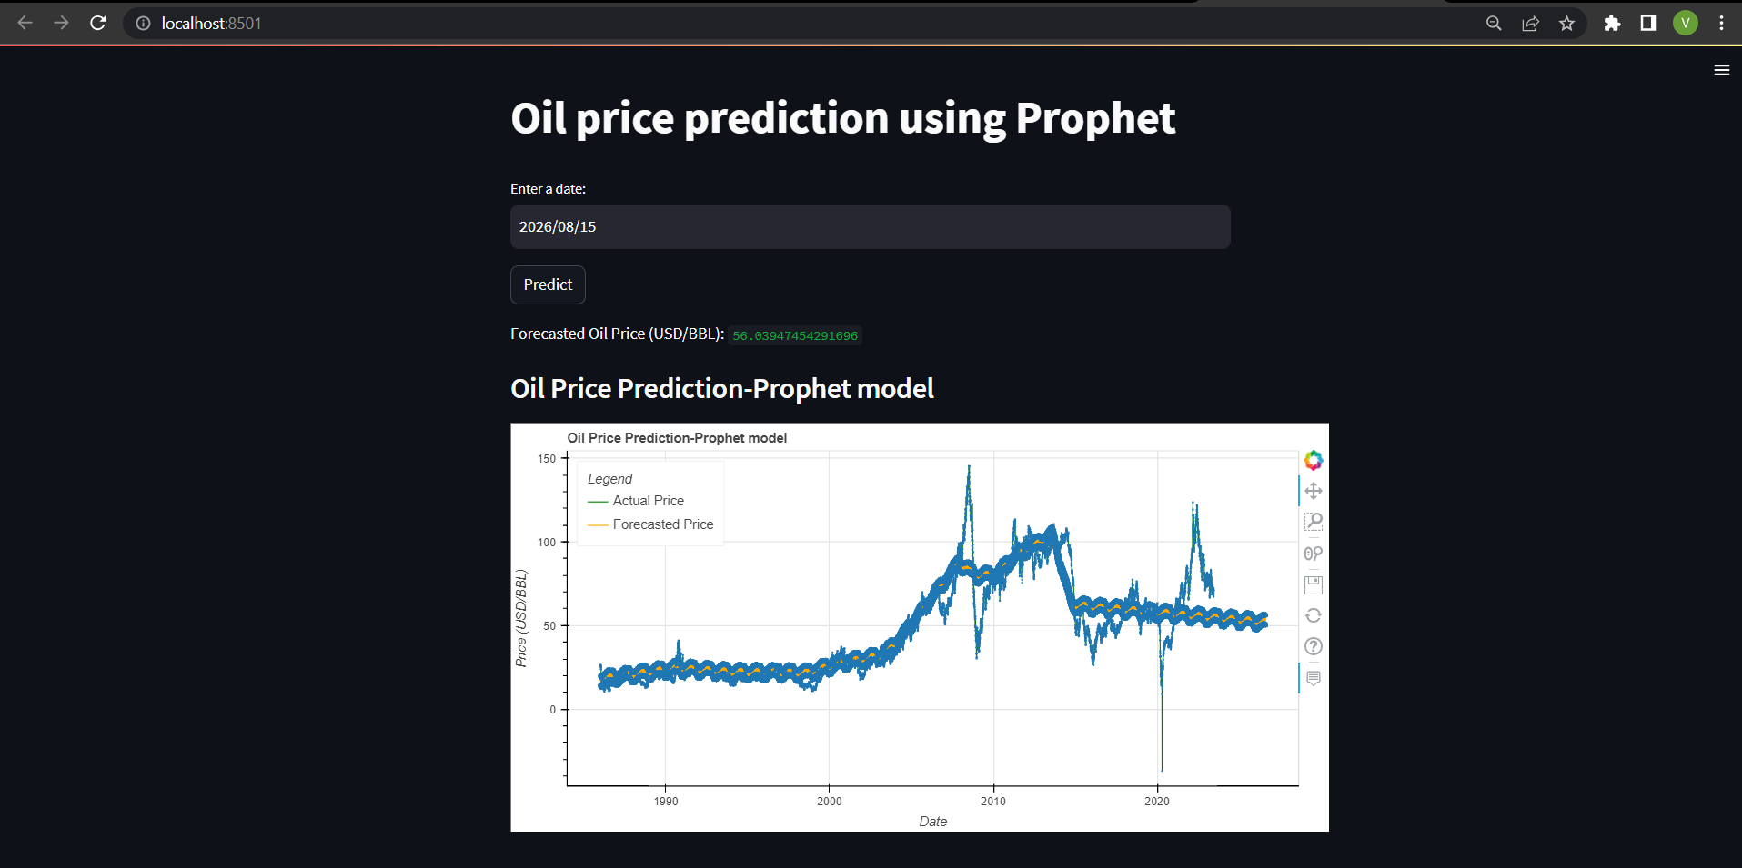
Prediction of prophet model:
Price prediction for the date 2026/08/15 is 56.03 (USD/BBL)

Slide 59
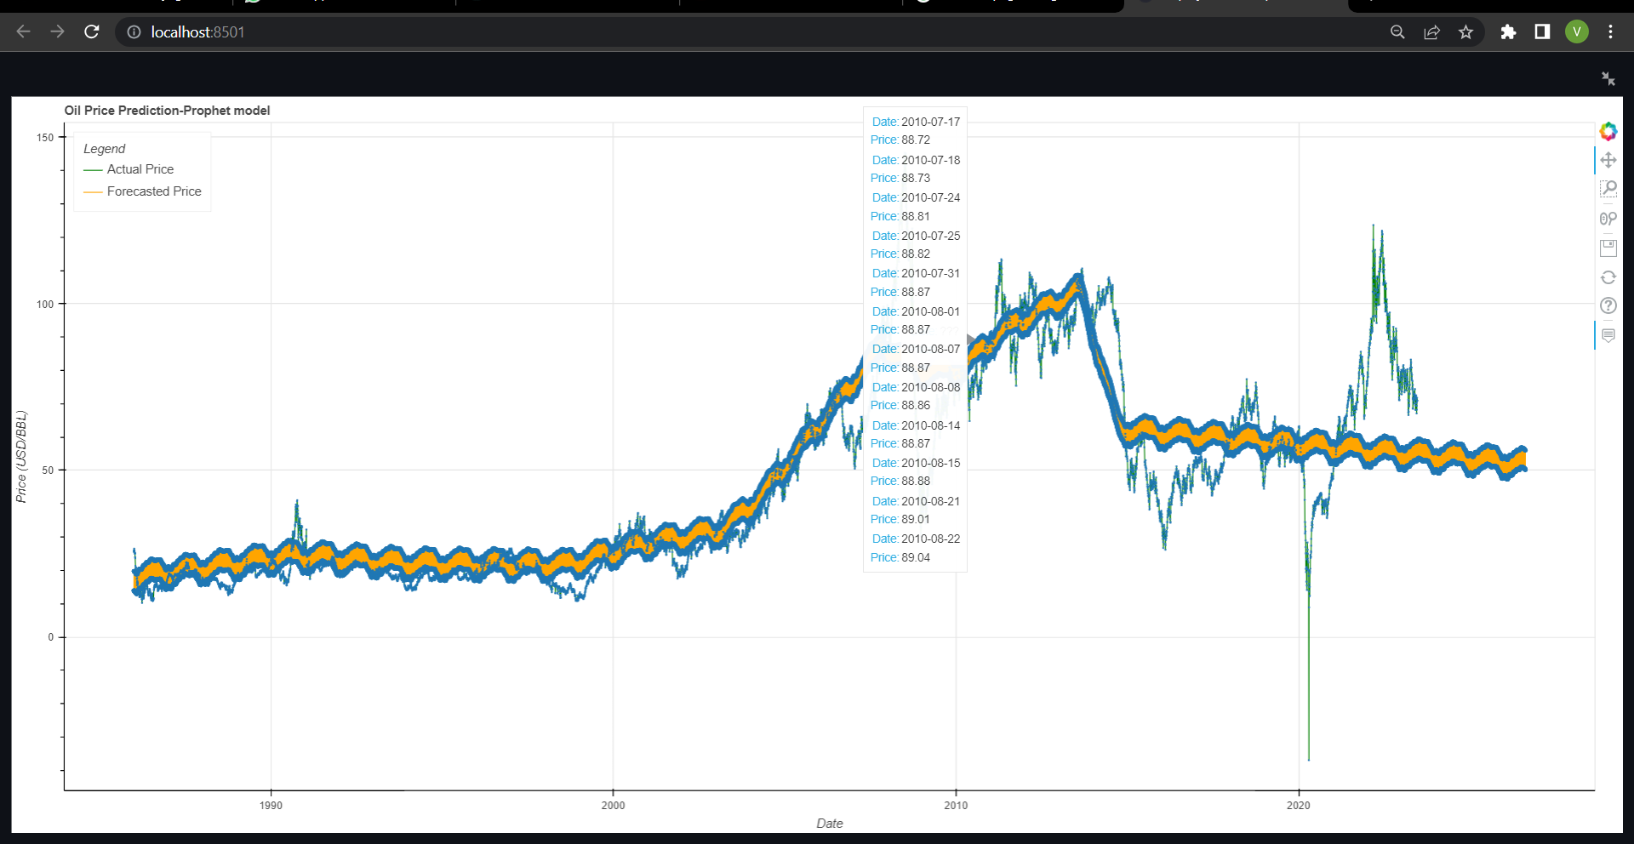
FB prophet model Forecasting :
The Forecasting shows a decreasing trend.
The graph continues to descend after a certain time period as if it fails to capture the increasing nature of the original time series.

Slide 60
Random forest deployment

Slide 61
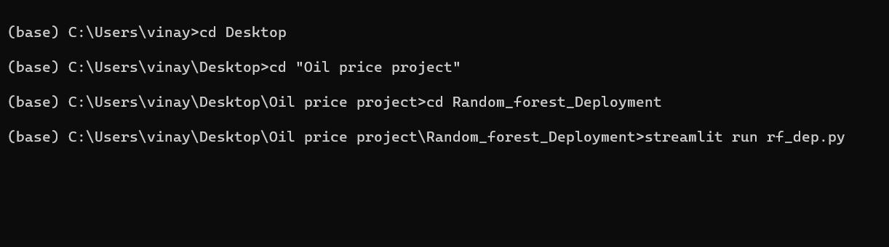
Anaconda prompt commands for Random_forest model:

Slide 62
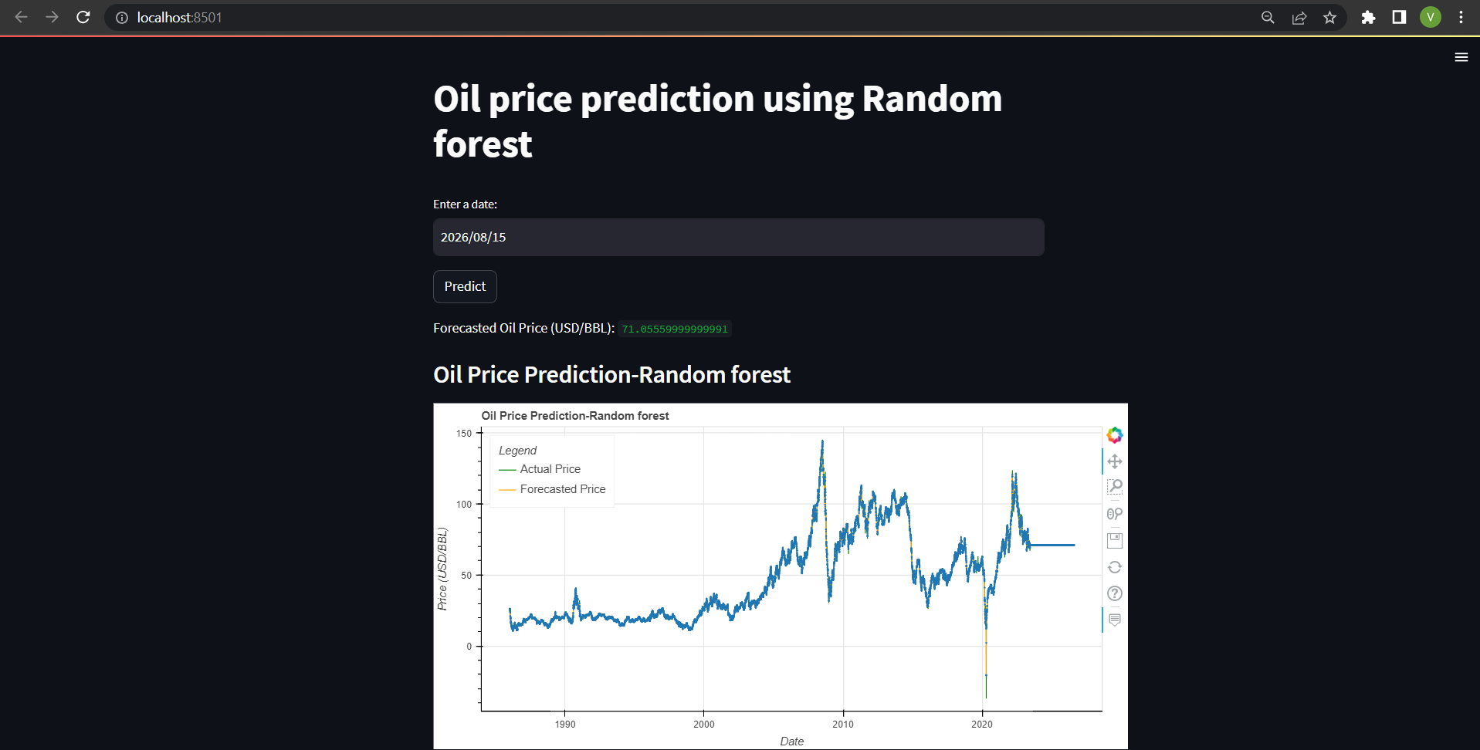
Random_forest model results :
Price prediction for the date 2026/08/15 is 71.05 (USD/BBL)

Slide 63

Random_forest forecasting :
The Forecasting shows a flat line, there is no trend and seasonality.
The prediction for all the future value is same.
The graph clearly shows the case of overfitting , the model is performing almost 100% for the training data but fails to captures the underlying trend and seasonality hence performing bad on new data.

Slide 64
Comparison :
Even though the RMSE value of Random forest is less than FB Prophet model , Random forest fails to capture the trend component and seasonality.
The Random forest shows a clear sign of overfitting and Prophet model performs well.
Since there are many external factors affecting the oil price which the Prophet model fails to capture , there is definitely room for improvement.

Slide 65
Challenges Faced :
Model selection: There are many different types of models that can be used to forecast time series data, and selecting the right one for a specific dataset was challenging.
Stationarity of data: In ARIMA model making the data stationary was challenging , we tried implementing differencing, log transformation combination of them to make the data stationary
Economic and political factors: Economic and political events can have a significant impact on oil prices, making it difficult to predict future movements.
Prediction part : All models require the data to be in a specific format , the prediction part in the prophet model required the data to be in a dataframe. It was challenging to figure that and deploy it.
Deployment : Using streamlit was very new and challenging. The comparison of model with the test data was commonly known but predicting for future values and implementing it in the web page form was challenging.

Slide 66
Thank You

